Slide 1
Learning & Development Enabling development, Impacting growth…
RDV-04
QlikView – Day 1

Slide 2
Module Outline
Introduction to QlikView
Associate Experience and Storage Mechanism
QlikView Colors
QlikView Architecture
Product Portfolio
Contents of a QVW File
QlikView Script Editor
Connect, Select and Load
Table Viewer
Introduction to UI Objects

Slide 3
QlikView - Introduction
Business Intelligence Tool – Simplifies Analysis and Decisions
Easy to Use – End users require No / Minimal Training
In-Memory – Near Instant Response Time on High Data Volumes
Insightful
Fast Implementation – Seeing is Believing
Broadly Distributed
Works on Associative Query Logic - Patented

Slide 4
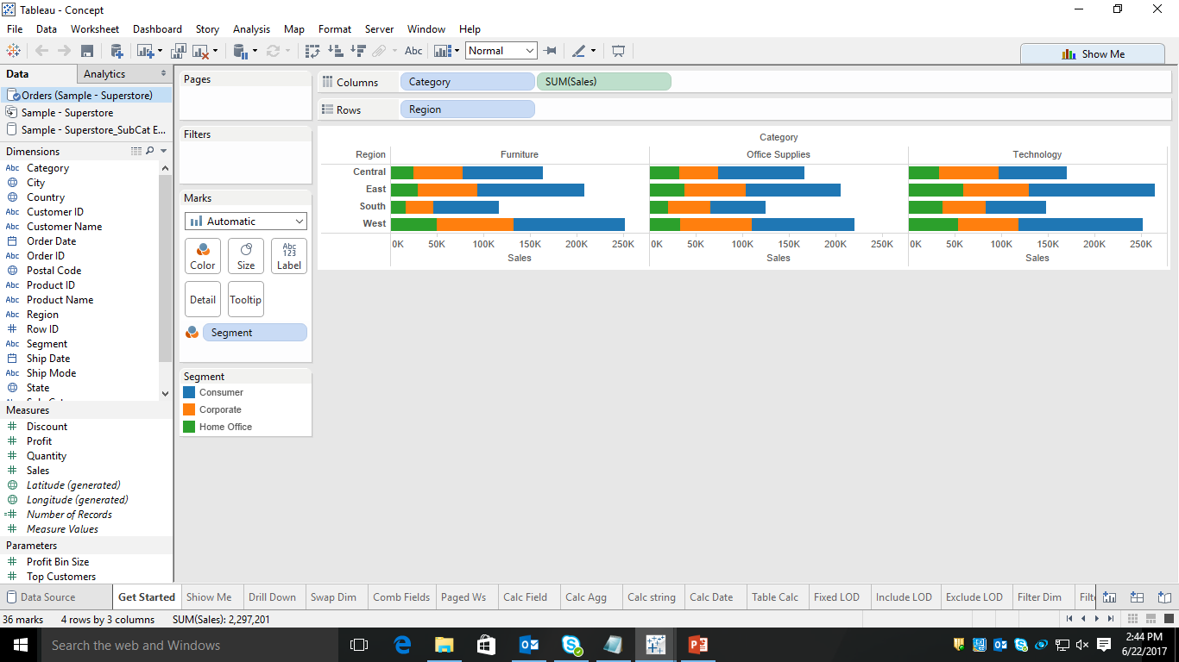
Introduction to Tableau
A data visualization tool with many important features
No scripting required
Any business user can use the and share the product

Slide 5
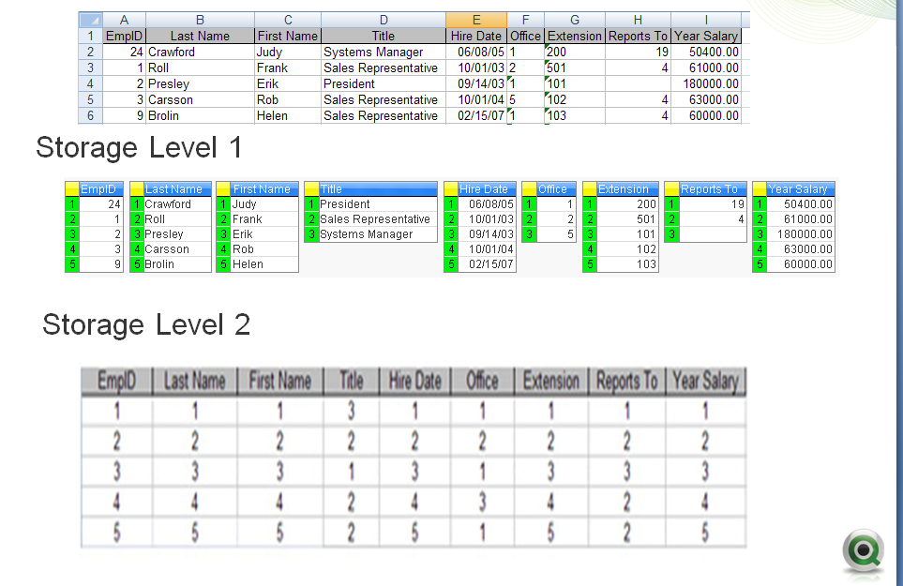
Associative Experience

Slide 6
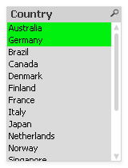
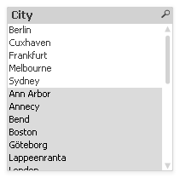
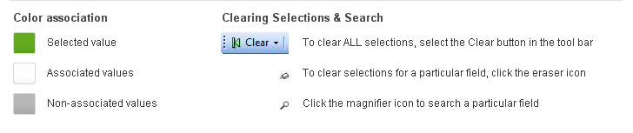
QlikView Colors
QlikView Colors – Green, White and Grey – Serves as a basis for Depicting Relationship

Slide 7
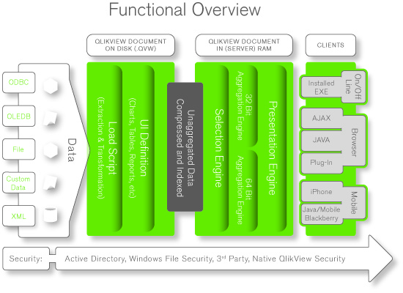
QlikView Architecture

Slide 8
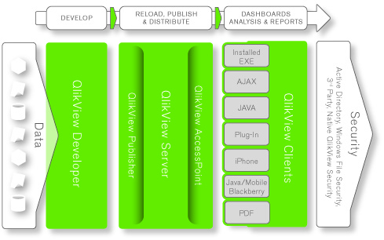
Product Portfolio
Desktop
(for the Developer)
Clients
(for the End User)
Server
(for Deployment of QVW)
Publisher
(for Distribution of QVW)

Slide 9
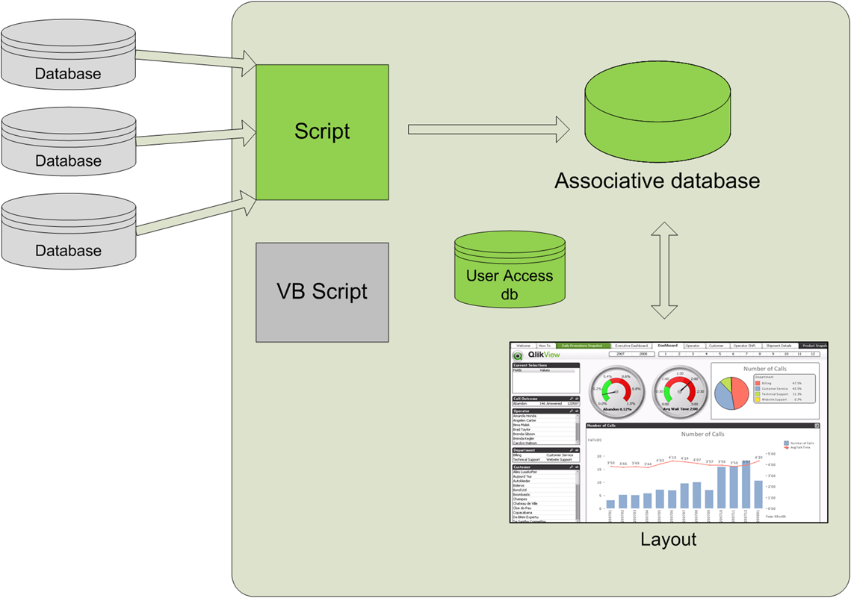
Contents of a QlikView File

Slide 10
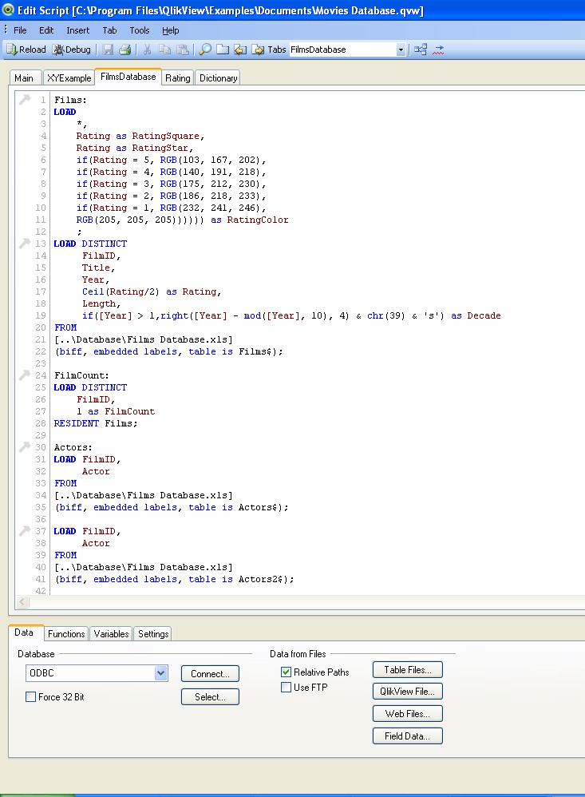
QlikView Script Editor
A: Menu Buttons
B: Script Area
C: Tool pane
D: Tabs

Slide 11
Connect, Select and Load
Connect – Establishes a link to a database
Select – Identifies the fields and tables to load from the current database connection
Load – Inserts data from Text File, Excel File, XML File, from previously loaded table / fields, from the result of the following select statement, from Data Defined in the Script, etc

Slide 12
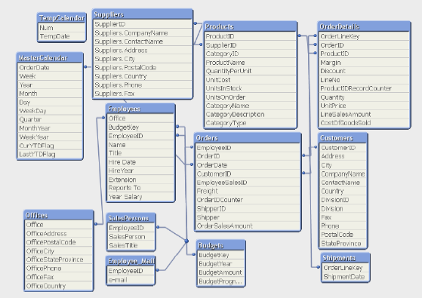
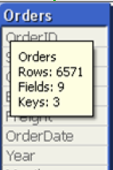
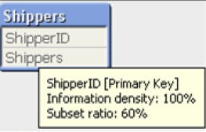
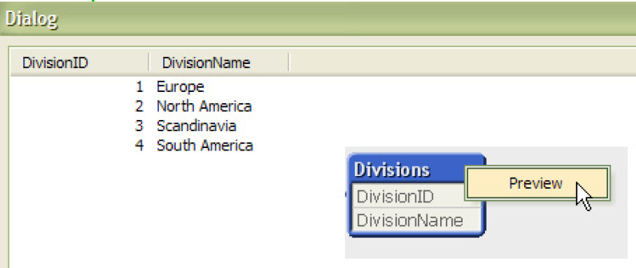
Table Viewer

Slide 13
Table Viewer (contd)
Source / Internal Table Views
Information Density
= Number of Not Null Values / Total Number of Records
Subset Ratio
= Number of Distinct Values of a Field in a Table / Total Number of Distinct Values of the Field in all Tables
Perfect Key – Key + Unique + Subset Ratio = 100
Primary Key – Key + Unique + Subset Ratio < 100

Slide 14

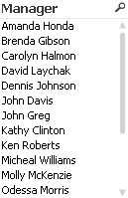
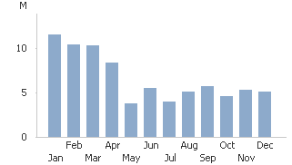
Introduction to UI Objects
UI Objects include Sheets (also referred as Tabs) and Sheet Objects (like Charts, Filters, Labels, etc)
Keep layout clear, not too many objects on one sheet
Promote / Demote a Sheet

Slide 15
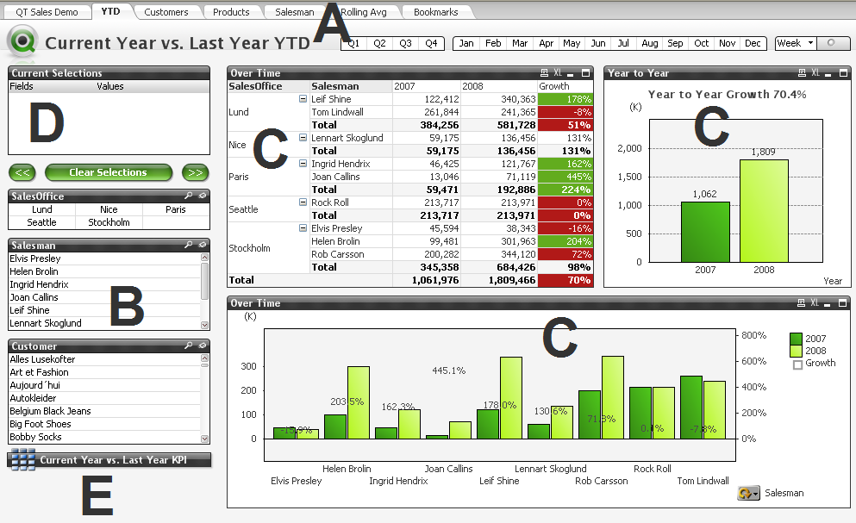
Anatomy of QlikView Sheet
The Basic Components of a QlikView Sheet — A: Tabs, B: List Boxes, C: Active Charts, D: Current Selections Box, E: Minimized Charts

Slide 16
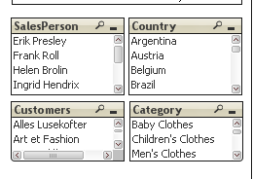
List Box
List Box – most Versatile Object
It contains a list of all possible values of a specific field loaded from the data source
Making a Query Using List Box
Text Search
Multiple Selections
Locking and Unlocking Selections
Notes:
Include a separate slide for search object

Slide 17
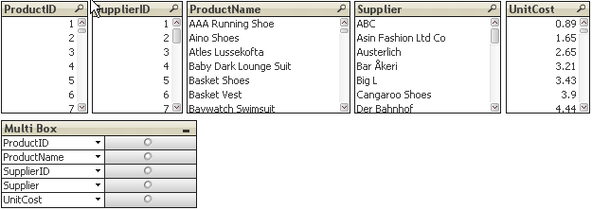
Multi Box
Space saving object
Can display large number of fields in small space, instead of several individual list boxes.
Less cluttered style
Best for displaying one-to-one relationship

Slide 18
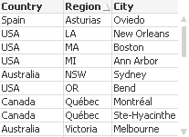
Table Box
Sheet Object showing Multiple Fields Simultaneously
Can contain Fields from different QlikView Table – however, calculated / derived fields cannot be added.
Every Row is Logically Connected

Slide 19
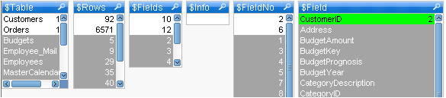
System Fields
Give information about the Data Model
Generated during the Data Loading Process
Contains Information on the Internal Data Structure within QlikView (i.e. Metadata about the Data Model)

Slide 20
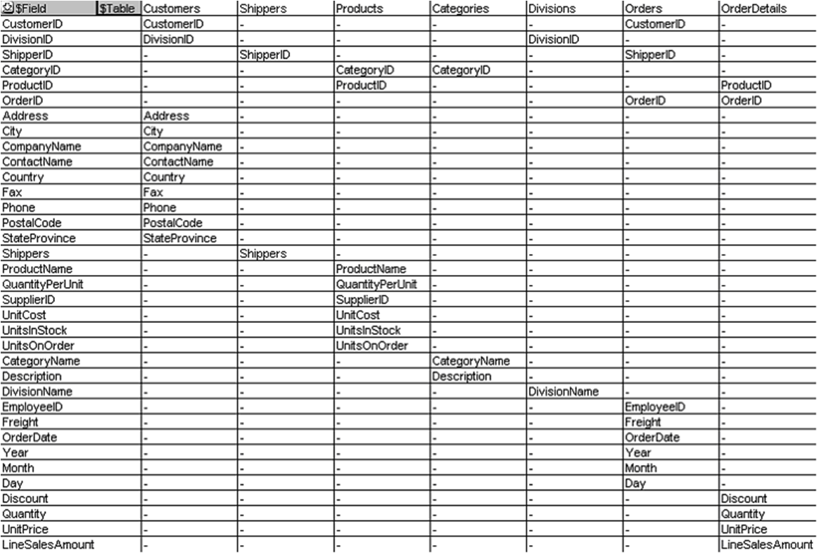
System Table
A Table Box in Pivot Style showing Relationship Between Fields and QlikView Tables
Can contain Fields from different QlikView Table – however, calculated / derived fields cannot be added.
Every Row is Logically Connected

Slide 21
Lab Work
Scripting:
Create a New QlikView Application. Revisit the script editor's features described in yesterday's session.
Bring in Products and Categories Tables using the attached data. Add the Supplier Table Data with the following fields only – SupplierID, CompanyName, Contact Name, City and Country. Visualize the relationship between these three tables (through Table Viewer). Look for Subset Ratio, Information Density and Keys.
While loading the above tables understand the significance of the Relative Paths
If you have got access to a specific database, try establishing the connectivity and bring in tables from there (if you don’t have one, you can look for an MS Access File from the internet, assuming you’ve got the Jet Driver to load data from it). Try out both OLEDB and ODBC Options. Understand the features of Preceding Load.

Slide 22
Lab Work (contd)
User Interface:
Rename the first Sheet from Main to My Sheet 1
Add Filters for Products, Categories and Suppliers. Find out different Products being available in Category – Beverages and Dairy Products. Add the same filters in a Multi Box to establish the hierarchy between these three filters. Enable the end user with a Search feature which enables them to search across these three fields
Add a New Sheet and name it System Fields and System Table. Adjust this sheet to be the first sheet of your application
Create a List Box for each of the System Fields available and Study the relationship between them. Visualize the same using a System Table.
Create a UI Object to show the data dump of the application fields (Products, Categories and Suppliers)

Slide 23
Q & A

Slide 24
Thank You
Review Date | 28-Aug-2015
Version | 1.0
Next Review Due | 28-Aug-2016

